Slide 1




SBV-LawGraph: A Hybrid RAG Approach Integrating Knowledge Graph for the State Bank of Vietnam Legal Documents
Khoa Phan, Xuan-Bach Le and Tho Quan
Kaohsiung, 14th April, 2026

Slide 2

TABLE OF CONTENTS
I
INTRODUCTION
II
RELATED WORKS
III
METHODOLOGY
IV
EXPERIMENT
V
CONCLUSION

Slide 3
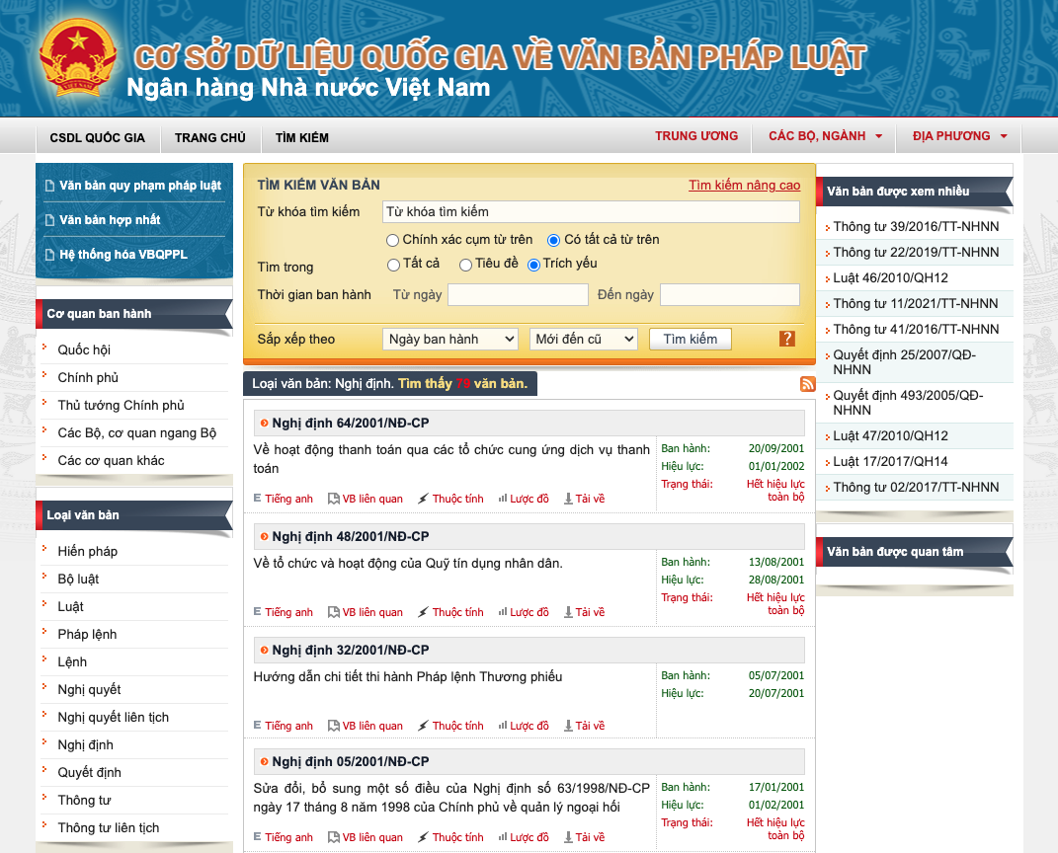
I. INTRODUCTION
Motivation: LLMs often hallucinate or make factual errors in specialized, knowledge-heavy domains like law.
The Challenge of Vietnamese Legal Documents: are inherently structured and densely interlinked.
Various types: Law, Ordinance, Decree, Circular,...
Complex relationships: Amend, Repeal, Replace, Guide,...

Slide 4

I. INTRODUCTION
Problem Statement:
Task: Legal QA for the State Bank of Vietnam (SBV) Legal Documents
Knowledge base: SBV legal corpus and Legal Knowledge Graph (LKG)
Input: Natural language question about SBV regulations.
Output: Grounded answer with clearly citation and related relationships.
Query
Answer

Slide 5
II. RELATED WORKS
Retrieval-Augmented Generation (RAG) is a common method.
Naive RAG:
Pros: Simple pipeline with Similarity Search
Cons: Lacks precision and misses crucial relationships between docs.
Advanced RAG:
Pros: Strong retrieval using Hybrid Search and Reranking
Cons: Lacks reasoning over complex legal references.
Graph RAG, Light RAG:
Pros: Captures relationships well with a better data visualization.
Cons: legal KG construction and multi-hop retrieval.
etc.

Slide 6
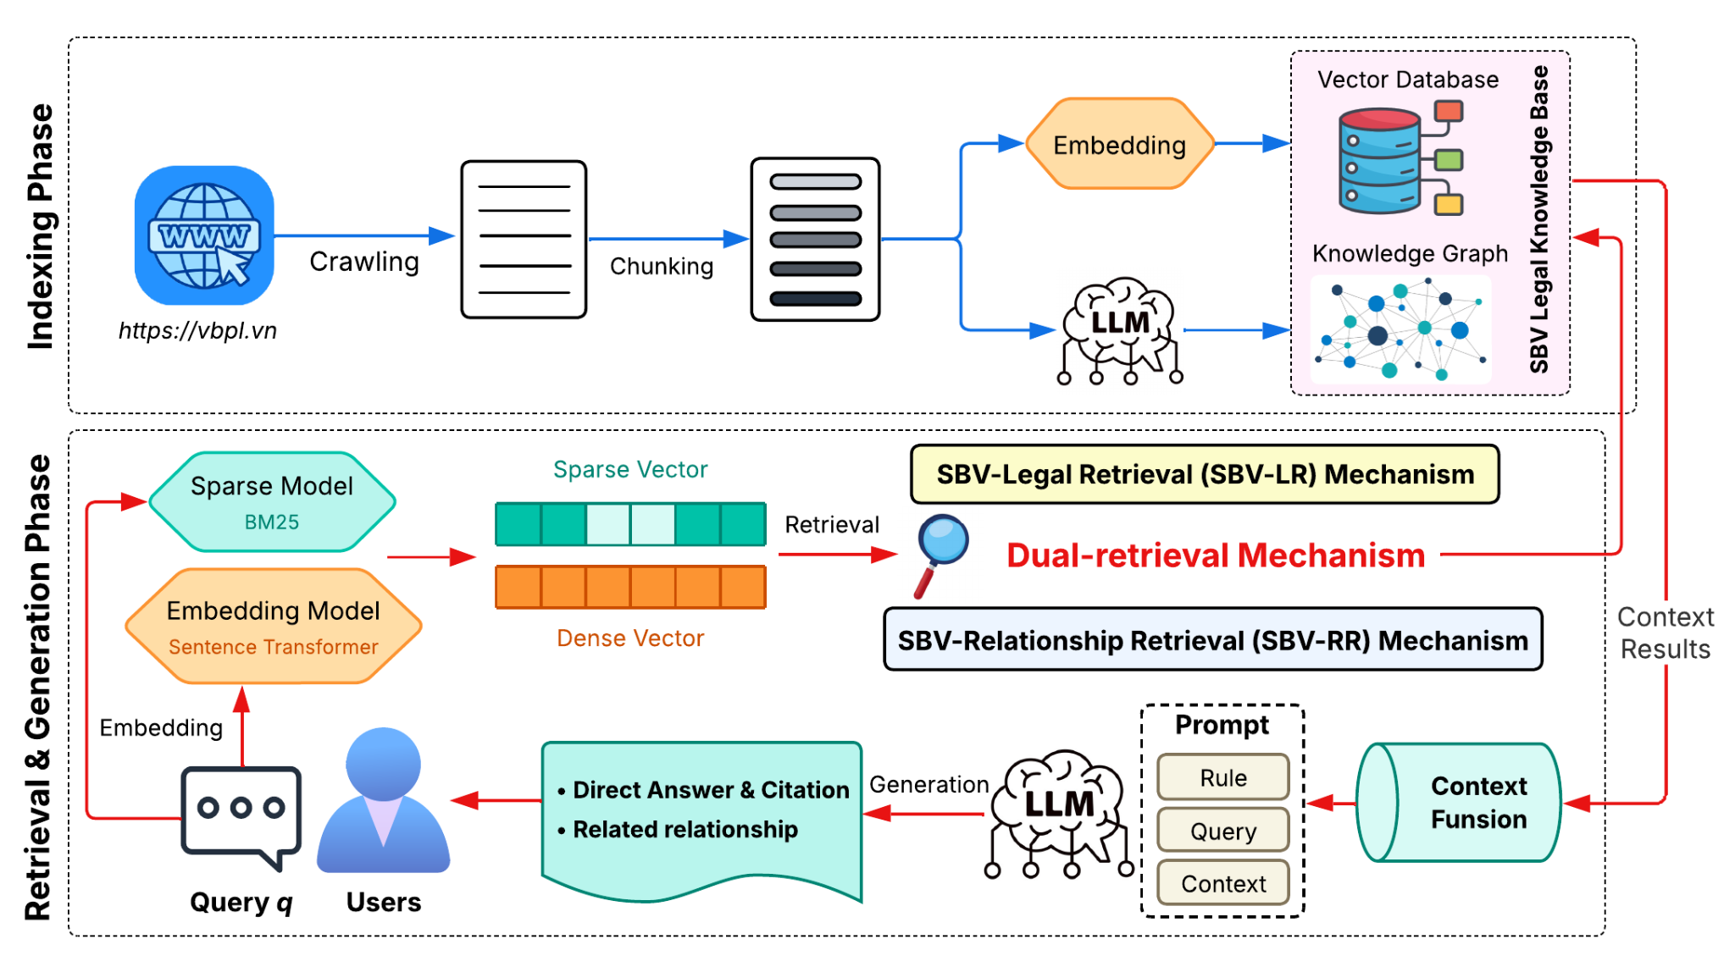
III. METHODOLOGY
SBV-LawGraph: A hybrid RAG approach designed for Vietnamese law.

Slide 7
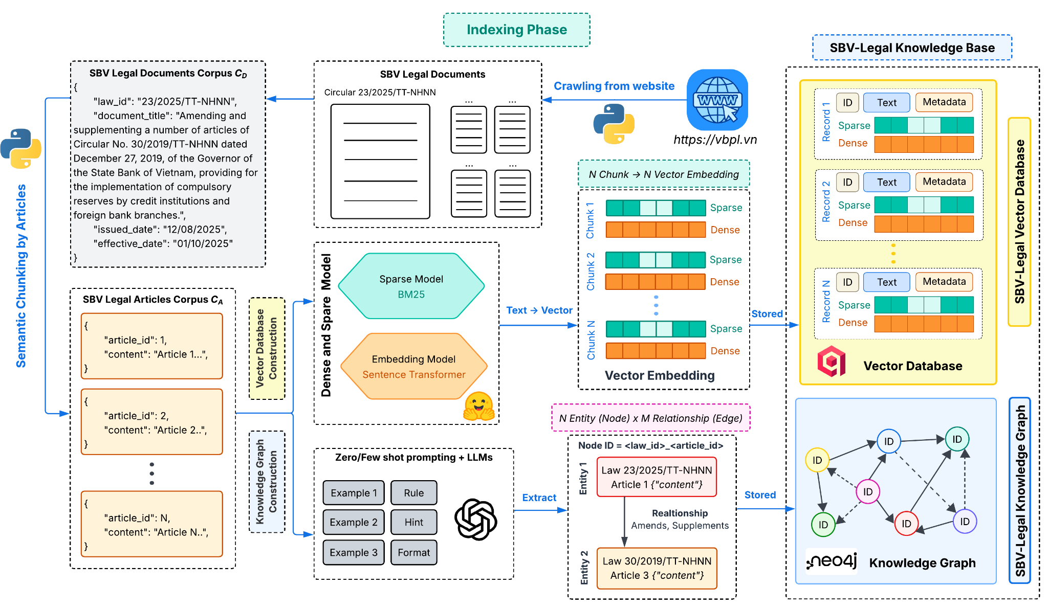
III. METHODOLOGY
where we start
How we construct the SBV Legal Knowledge Base?

Slide 8
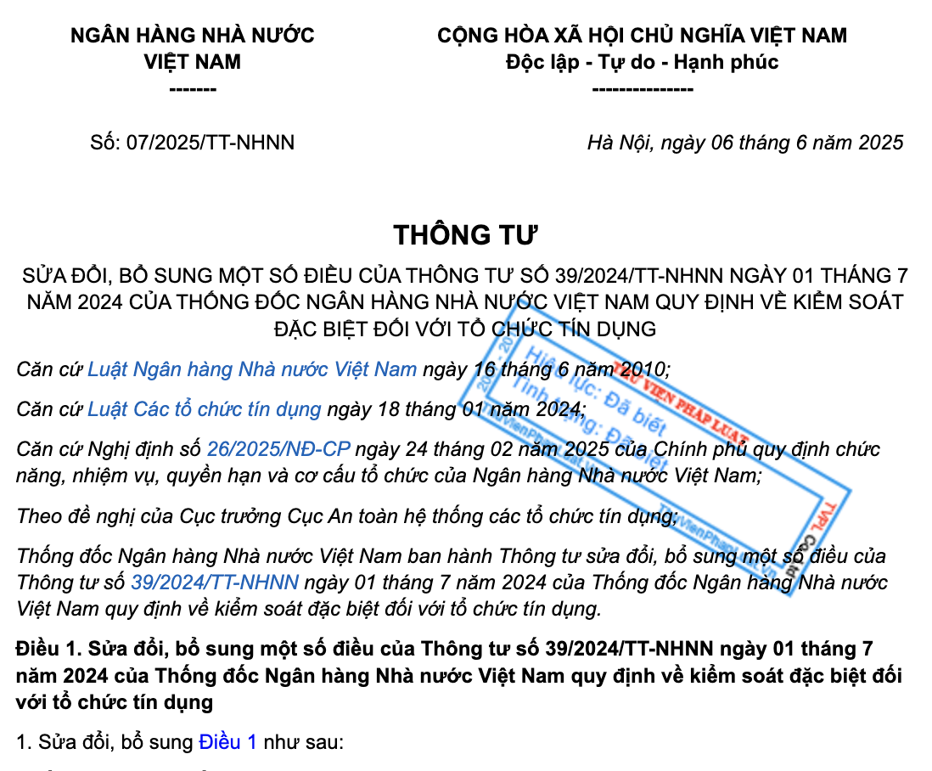
III. METHODOLOGY
Document
Document Title
Article 1: Amend Circular 39/2024/TT-NHNN content

Slide 9
III. METHODOLOGY
Key Components:
SBV-LR (Legal Retrieval): using vector database
Hybrid Search (BM25 + Similarity) → Reranking
Output: Top k Related Articles and Documents content
SBV-RR (Relationship Retrieval): using knowledge graph
Onehop retrieval → Articles context and relationship
Output: Legal relationship augmented context.
Context Fusion: Merge all the context into a unified prompt → Generation
Controlled Fallback: Return an "Unknown Answer" if evidence is lacking.

Slide 10
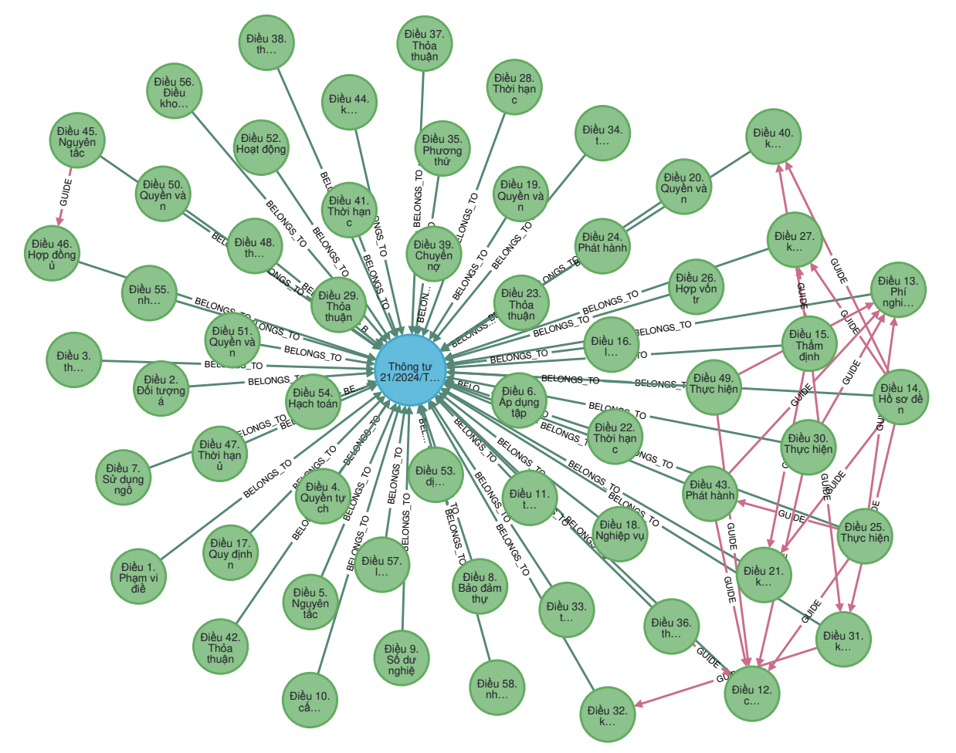
IV. EXPERIMENT
Experimental Setup:
SBV Legal Corpus: 840 documents currently in force with 9.661 articles.
Embedding Model: minhquan6203/paraphrase-vietnamese-law-embedding
Reranking Model: BAAI/bge-reranker-v2-m3
LLMs: gpt-oss-120b
Nodes: Documents and Articles
Relationship: BELONGS_TO, AMEND, REPEAL, REPLACE, GUIDE.

Slide 11
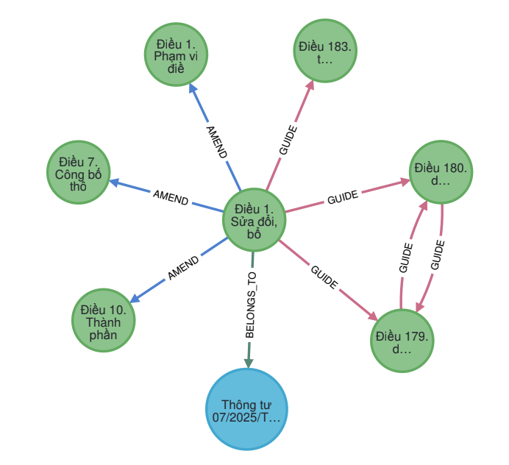
IV. EXPERIMENT
{
"elementId": "4:dcaa8338-b779-40aa-8999…",
"id": 20703,
"node_id": "07/2025/tt-nhnn_1",
"law_id": "07/2025/tt-nhnn",
"title": "Điều 1. Sửa đổi, bổ sung một số điều của Thông tư số 39/2024/TT-NHNN ngày 01 tháng 7 năm 2024 của Thống đốc Ngân hàng Nhà nước Việt Nam quy định về kiểm soát đặc biệt đối với tổ chức tín dụng",
"content": "Điều 1. Sửa đổi, bổ sung một số điều của Thông tư số 39/2024/TT-NHNN ngày 01 tháng 7 năm 2024 của Thống đốc Ngân hàng Nhà nước Việt Nam quy định về kiểm soát đặc biệt đối với tổ chức tín dụng...",
"embedding": "[-0.0732748806,-0.0150016723,...]",
"sparse_embedding": {
"82": 1.044880980432029,
"165": 1.6357093091089323,
"...": "..."
}
}

Slide 12
IV. EXPERIMENT
Experimental Setup:
Evaluation Benchmarks:
ALQAC2025 for information retrieval benmark: 729 QA pairs.
SBV Legal Dataset for QA benchmark: 100 real-case QA pairs.
Retrieval Metrics:
Information retrieval (IR): Recall, Precision, MRR, F2 Score
QA Quality: Correctness evaluated by two annotators with experience in banking domain..
Baselines Model:
IR: BM25, Naive RAG, AdvancedRAG (75% BM25, 25% semantic).
QA Quality: ChatGPT-5 and Gemini-2.5-Pro.

Slide 13
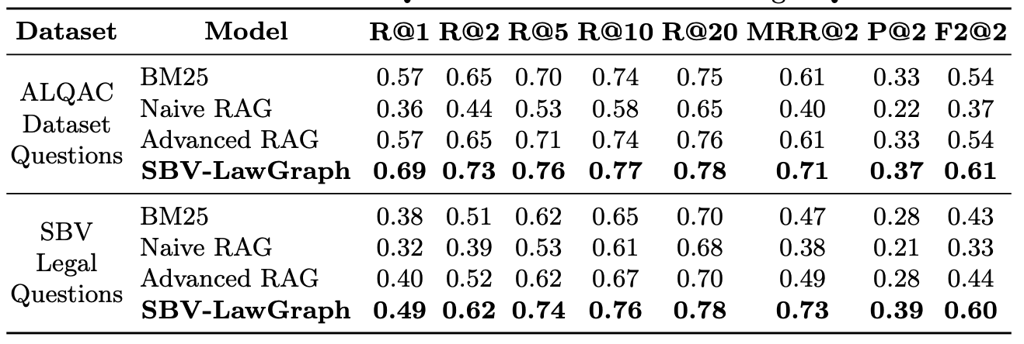
IV. EXPERIMENT
Result for Information Retrieval Task

Slide 14
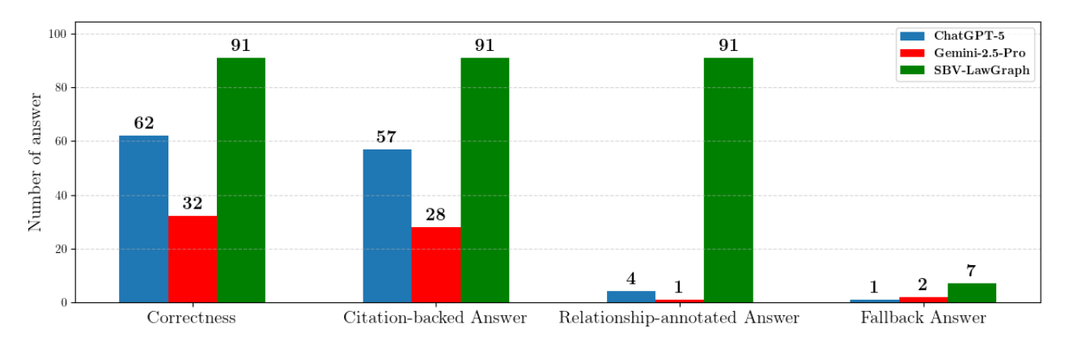
IV. EXPERIMENT
Result for Legal QA Quality Task

Slide 15
V. CONCLUSION
SBV-LawGraph successfully integrates semantic signals and knowledge graph reasoning to generate accurate, citation-backed legal answers.
Retrieval Metrics:
Highest Recall on both dataset (at k=5: +5-12% over Advanced RAG).
Highest F2 Score on both dataset (at k=2: +7-16% over Advanced RAG)
Generative Performance:
Consistently outperforms ChatGPT-5 (~ +30%) and Gemini-2.5-Pro (~ +60%).
Delivers high correctness, reliable citation inclusion, and legal consistency

Slide 16
V. CONCLUSION
Future Work:
Expand the variety of knowledge base.
Develop a benchmark datasets for relationship extraction to reduce bias.
Refine evaluation protocols via ablation studies on SBV-LR and SBV-RR.
Conduct user-centered studies with domain practitioners to assess real-world utility in Vietnamese legal domain.

Slide 17

THANK YOU FOR YOUR ATTENTION
pqkhoa.sdh231@hcmut.edu.vn
(+84) 94 8830 791

